Slide 1
Sentiment Analysis of COVID-19 Tweets – Visualization Dashboard
Submitted By:
Application ID: SPS_CH_APL_20200005849
Team Name: Zerobugz
Name: Manasa
SBID: SB20200047593
Email: manasa7919@gmail.com
Name: Narendra
SBID: SB20200068820
Email: narendranairy19@gmail.com
Name: Nikhil V
SBID: SB20200047588
Email: nikhilshettigar269@gmail.com

Slide 2
About the Project
Problem Statement:
Sentiment Analysis of COVID-19 Tweets – Visualization Dashboard
The sentiment analysis of Indians after the extension of lockdown announcements to be analyzed with the relevant #tags on twitter and build a predictive analytics model to understand the behavior of people if the lockdown is further extended. Also develop a dashboard with visualization of people reaction to the government announcements on lockdown extension.
Proposed Solution:
We have taken Geo-tagged dataset from IEEE dataport and extracted tweets using a tool called hydrator and extracted all tweets with location India then calculated the number of positive, negative and neutral sentiments to find past sentiments of people regarding this pandemic and later built LSTM model to predict how people might react if government decides to extend the lockdown. LSTM stands for Long Short Term Memory which predicts each value by considering specified number of past values. We have also displayed the tweets with their sentiments in the User interface. User Interface is built using both React and Node red frame work

Slide 3
Steps Undertaken
Data collection
Extract tweets using the hydrator using tweet ID
Cleaned the data
Predicted number of positive negative and neutral sentiments
Represented the values using Pie chart in Node red and Using React framework
Calculated average value of sentiments of each day
Built LSTM model which predicts how the sentiments vary in future
Plotted the predicted values with respect to dates in Node red and Using React framework
Uploaded the tweets and their sentiments in DB2 and displayed it using Node red
Drawn a conclusion from the graph

Slide 4
Working with LSTM model
Extracted the dataset and filled the null values
Created a copy of the data
Spitted the data for training and testing
Applied feature transform
Formed each Xtrain and Ytrain values based on pass 12 days
Trained the model
Formed Xtest
Predicted the values for future dates
Plotted using line chart

Slide 5
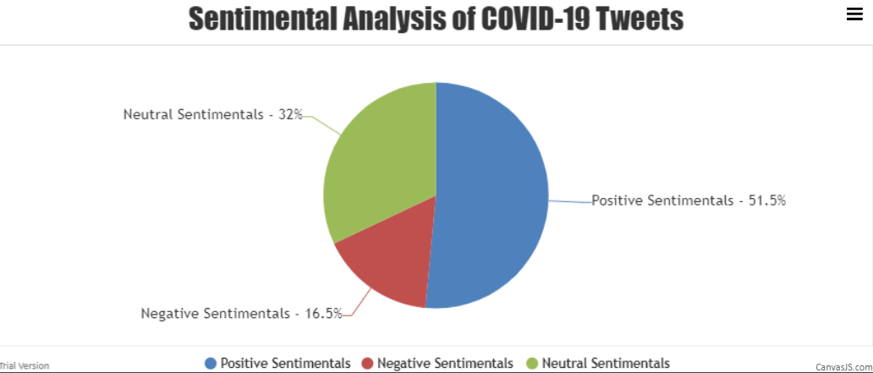
Result

Slide 6
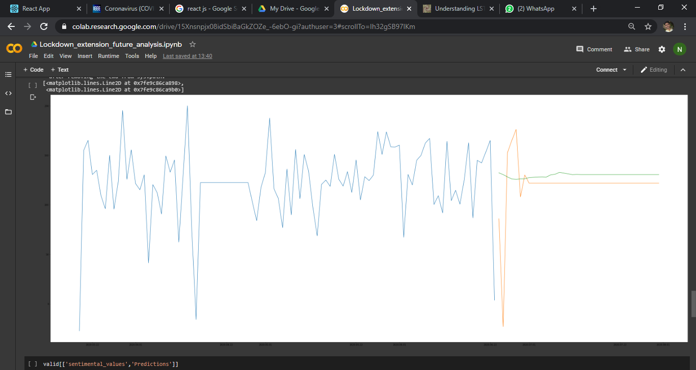
Result
Orange line indicates the tested data and green indicates the future prediction about lockdown extension. From the pie chart it is observable that Positive Sentiments > Neutral Sentiments > Negative Sentiments and in the graph maximum of average sentiment values are between 50 and 175(0.05-0.175) and also the future predicted values are within the same range.
This gives a conclusion that if government decides to extend the lockdown there will be more positive sentiments and neutral sentiments due to the uncontrolled increase of number of patients effected due to corona, people think of protecting themselves so support the lockdown.
There might be some number of negative sentiments also with regards to increase in number of deaths and unemployment and lack of money due to no work indicating such situations.

Slide 7
Conclusion
There is possibility that this model might not be accurate but the past responses of people towards corona and lockdown shows that they will support the extension of lockdown. The result from this model can be improved may be with different algorithms and also using more data. This project can be improved and made efficient in two ways, we can add a form which takes input from the user and predicts the sentiments and built a real time model which continuously takes inputs from twitter and plot and predict in real time.

